Slide 1
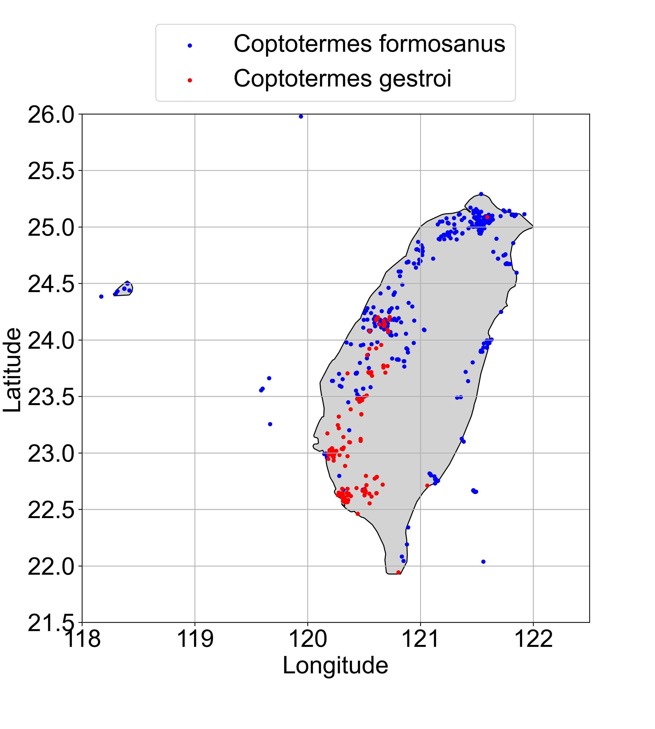
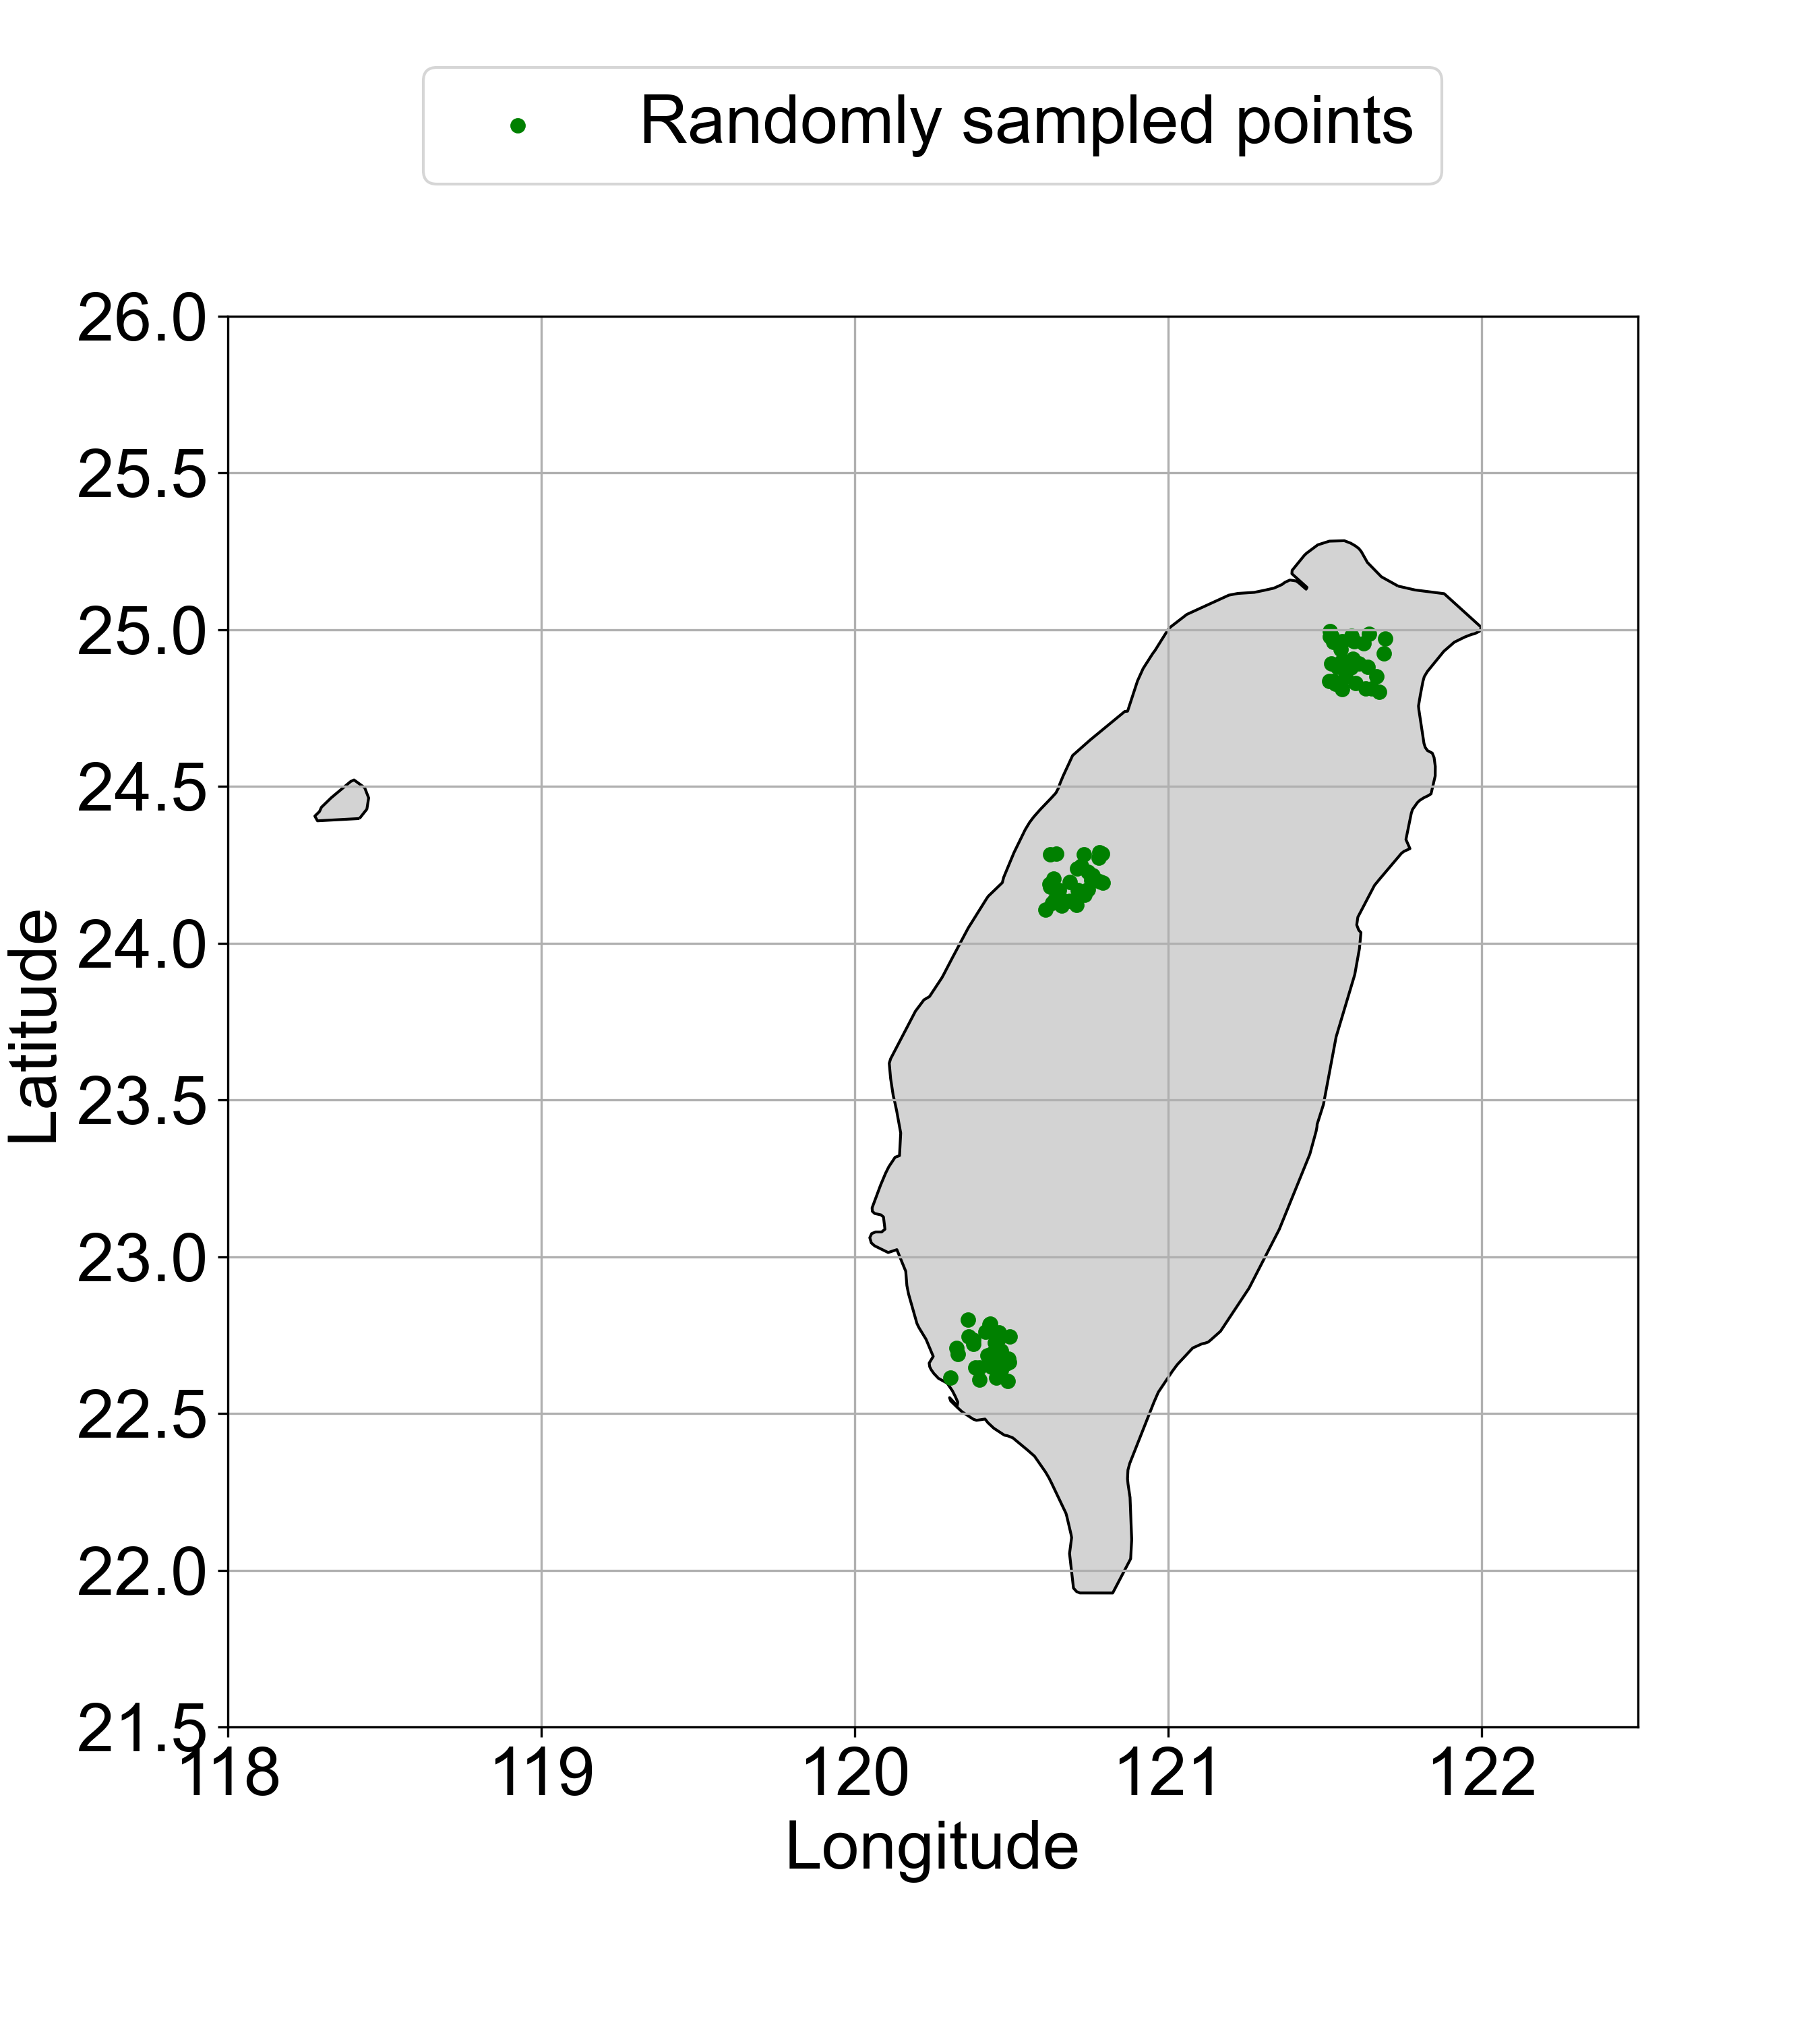
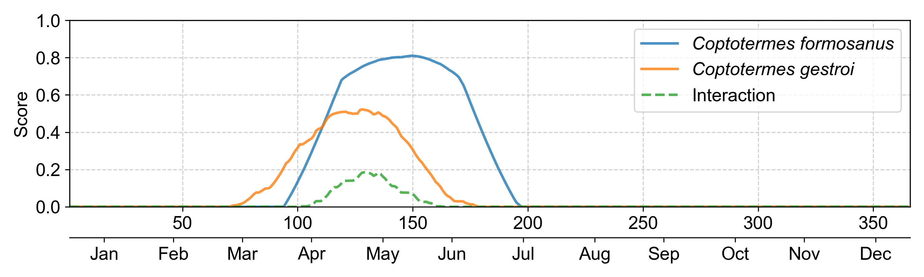
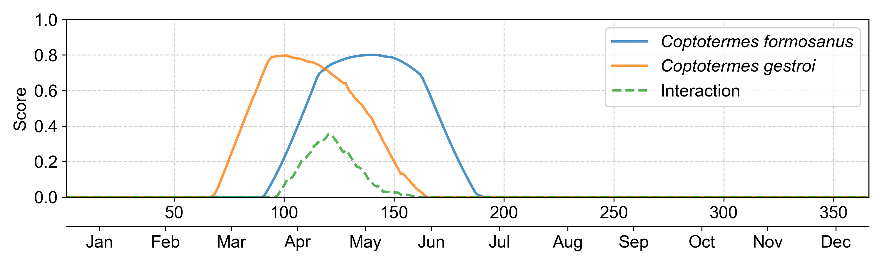
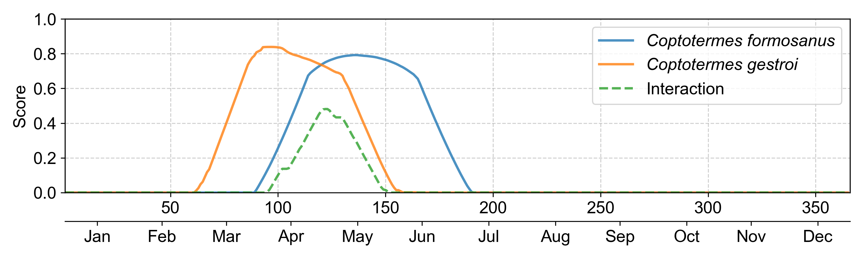
A
B
Northern
Middle-western
Southern
C
Northern
Accumulated
interaction score = 5.39
D
Middle-western
Accumulated
interaction score = 9.55
E
Southern
Accumulated
interaction score = 14.25

